Slide 1










Deloitte Talk | Together Makes Progress: Connecting People, Startups & Opportunity in Patras
February 2026

Slide 2
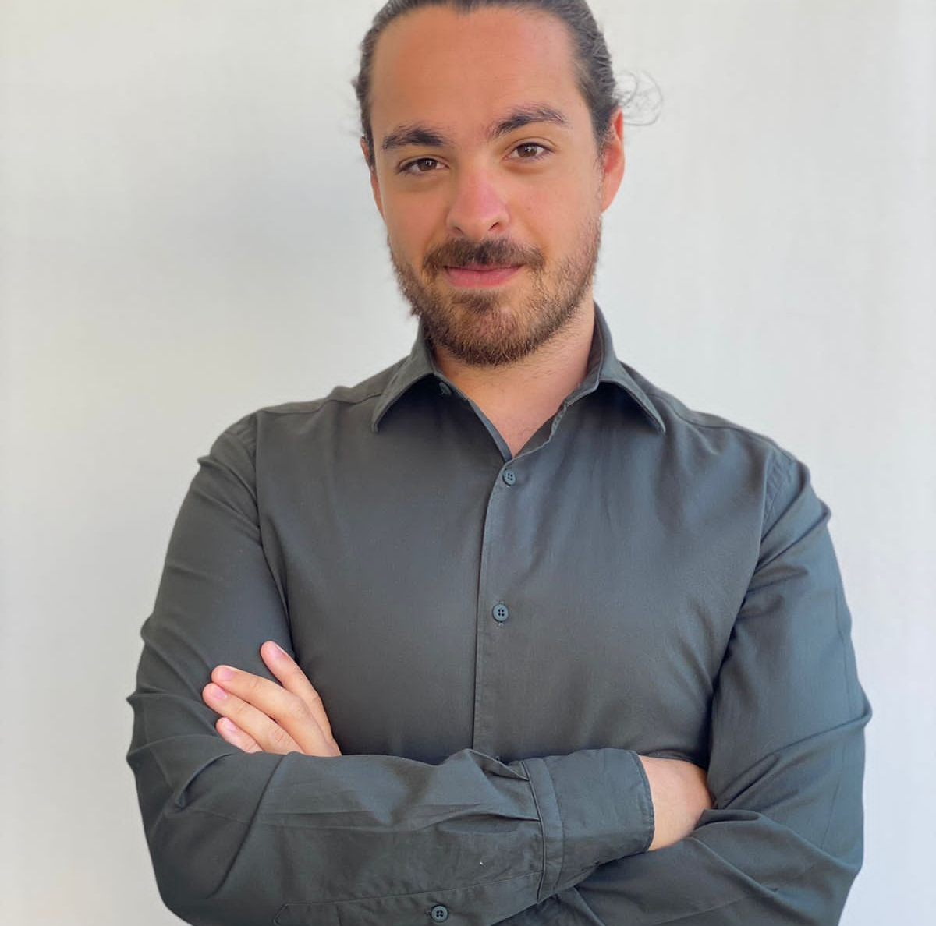

Introduction | Meet Our Team
Constantinos Panayi
Assistant HR Manager
Giorgos Stratigis
Assistant Manager, SR & TA
© 2026 For more information contact Deloitte Central Mediterranean | 02

Slide 3


Introduction | Rules of Engagement​
Please feel free to
ask questions and
challenge our
points to maximize
value.
Let’s try to make this as
interactive as possible in order to cover what you consider relevant.
We aspire this to be the beginning
of an ongoing communication/
relationship so please feel free to
contact us directly for any
questions, clarifications,
considerations, etc.
© 2026 For more information contact Deloitte Central Mediterranean | 03

Slide 4



















Why Deloitte | Who We Are​
Deloitte Greece provides Audit & Assurance, Tax & Legal, Strategy, Risk & Transactions Advisory, and Technology & Transformation services to leading public and private clients in the Greek market and abroad.
Deloitte Greece is a member of Deloitte Touché Tohmatsu (DTT) since 1975.​
Having followed a 50-year period of successful and dynamic activity in the Greek market, Deloitte Greece has experienced the largest growth among all international advisory firms by offering services to large public, private, commercial, and industrial companies in every major sector of the Greek economy.​
With offices in Athens, Thessaloniki, Patras, Heraklion & Ioannina Deloitte Greece employs more than 3,000 professionals. ​
Deloitte today enjoys one of the highest positions in the Greek market with a blue-chip portfolio of clients. We work with our clients to address their individual organizational challenges and opportunities, drawing on our extensive strategy, people, processes and technology capabilities to deliver targeted and integrated business improvement programs.​
© 2026 For more information contact Deloitte Central Mediterranean | 04

Slide 5














Deloitte | Deloitte Greece at a Glance​
Our local practice has experienced dynamic growth by investing in our people and their development​.
New Hires in FY25
891
People Growth
+3,3%
Women
43%
Partners
64
Average Age
33
Education FY25
~ €1.8M &
~ 74K Hours
People
3.100+
© 2026 For more information contact Deloitte Central Mediterranean | 05

Slide 6








Deloitte | Our Values​
Deloitte’s multi-dimensional approach connects the talents of more than 470k professionals and extensive alliances to uniquely provide clients with the breadth of perspective needed to deliver breakthrough solutions​.
Our Shared Values​
Lead the way​
With our unmatched scale, scope, skill, and service excellence, Deloitte is not only leading the profession, but reinventing it for the future. And we are putting those same attributes to work in our communities, creating opportunity and leading the way to a better, stronger, and more sustainable world.​
Foster inclusion​
We are at our best when we foster an inclusive culture and embrace diversity in all forms. We know this attracts top talent, enables innovation, and helps deliver well-rounded client solutions. We are committed to empowering all people to grow and achieve, accelerating diversity in leadership, and building balance for the better.​
Serve with integrity​
By acting ethically and with integrity, and serving as role models in our communities, Deloitte has earned the trust of clients, regulators, and the public. Upholding that trust is our single most important responsibility – the reason we do what is right, always.​
Collaborate for measurable impact​
We approach our work with a collaborative mindset, teaming across businesses, geographies, and skill sets to deliver tangible, measurable, attributable impact. We measure our success not only by metrics, but by the strength of the relationships we build, the level of innovation we bring to solving problems, and the company we keep as we deliver the best of Deloitte to the world.​
​
Take care of each other​
Deloitte’s culture is grounded in the understanding that “we are all in this together.” We look out for one another and prioritize respect, fairness, development, and well-being.​
© 2026 For more information contact Deloitte Central Mediterranean | 06

Slide 7













Why Deloitte | Global footprint
Deloitte continues to set industry standards by innovating and adapting to the evolving business landscape.
470,000
People Worldwide
>150
Countries/Territories
+700
Offices
© 2026 For more information contact Deloitte Central Mediterranean | 07

Slide 8


Why Deloitte | Global footprint
FY
FY
FY
25
24
23
$70.5B (+5%)
$67.2B (+3.1%)
$64.9B (+14.9%)
FY
FY
Deloitte is the world’s largest professional services network in terms of both revenue and headcount and is recognized as a market leader by independent analysts​.
$59.3B (+18.1%)
$50.2B (+5.5%)
© 2026 For more information contact Deloitte Central Mediterranean | 08

Slide 9
Why Deloitte | Our Service Portfolio
Our service portfolio is wide and covers a broad spectrum, aspiring to meet our clients’ ever-growing needs.
Audit & Assurance (A&A)
Tax & Legal (T&L)
Strategy, Risk & Transactions Advisory (SR&TA)
Technology & Transformation (T&T)
Audit
Tax
Strategy & Transactions
Cyber
Assurance
Global Employer Services
Risk, Regulatory & Forensic
Engineering,
AI & Data
Business Process Solutions
Enterprise Technology & Performance
Legal
Customer
Human Capital
© 2026 For more information contact Deloitte Central Mediterranean | 09

Slide 10
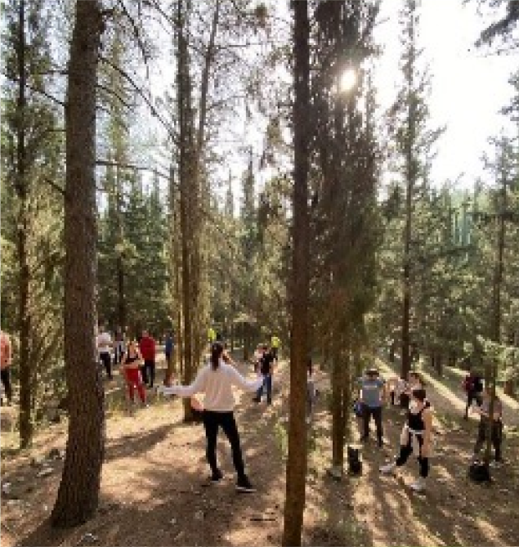










Deloitte | Sports & Social Clubs​
​In collaboration with our various Clubs lead by Deloitte Professionals, we are participating frequently in marathons, tournaments, hikes and many more outdoor activities!​
Hiking Team
Basketball League
Photography Team
Chess Club
Football League
Book Community
Running Team
Bowling Team
Tennis Club
Volleyball Club
Pet Community
© 2026 For more information contact Deloitte Central Mediterranean | 10

Slide 11
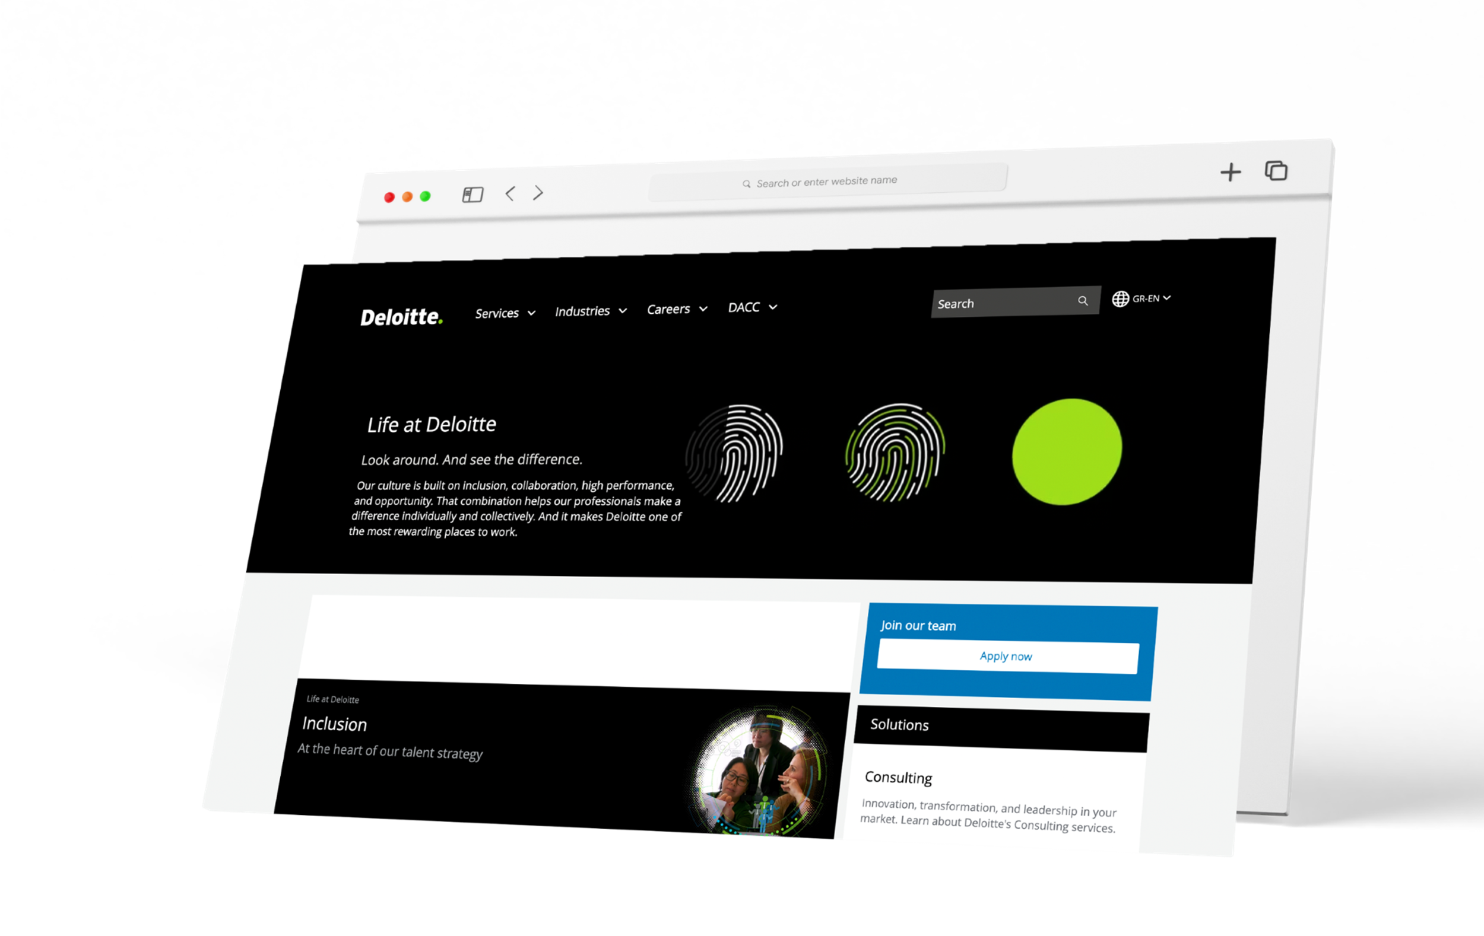






Join our Team | Apply Now!​
www.deloitte.gr
VISIT
© 2026 For more information contact Deloitte Central Mediterranean | 11

Slide 12

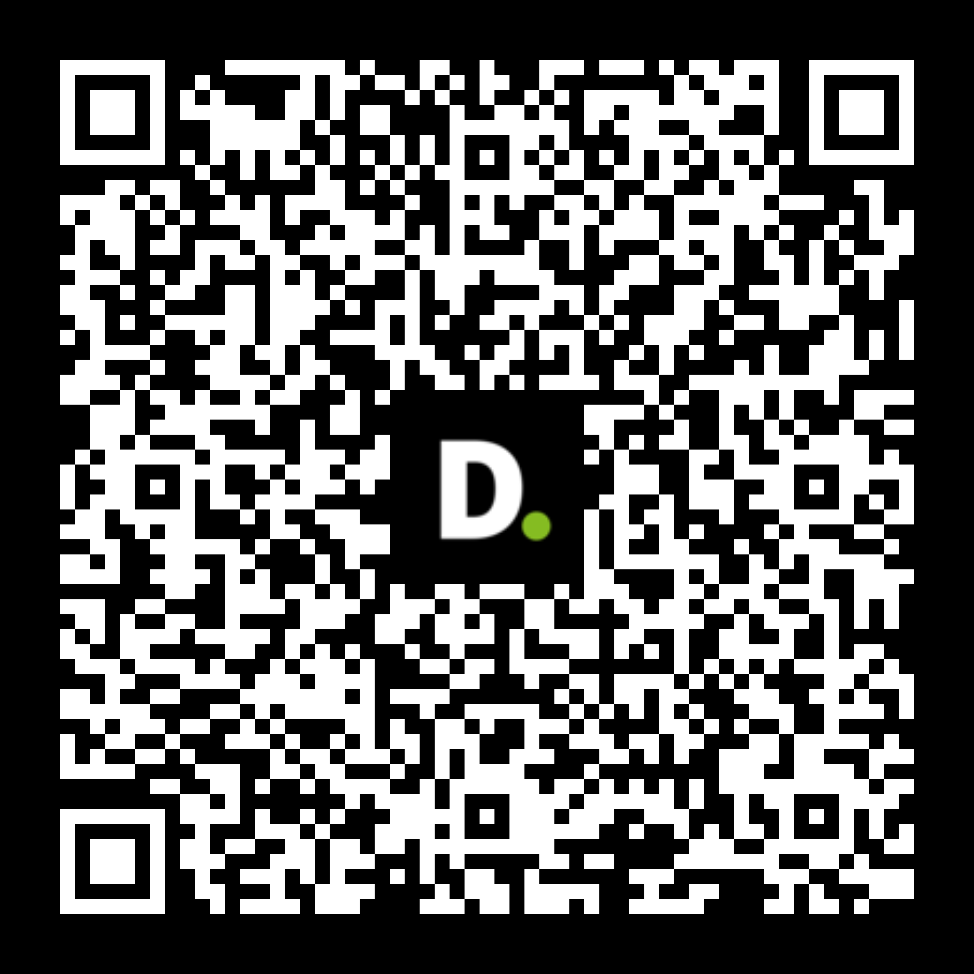






Join our Team | Apply Now!​
More than 100 open positions @Deloitte are waiting for you to apply!​
Check our activities and vacancies in our social media! ​
Feel free to contact us for anything you may need. ​
We will be happy to discuss further with you!​
Thank you all!
© 2026 For more information contact Deloitte Central Mediterranean | 12

Slide 13


BRAINZONE Deloitte Startup Accelerator

Slide 14
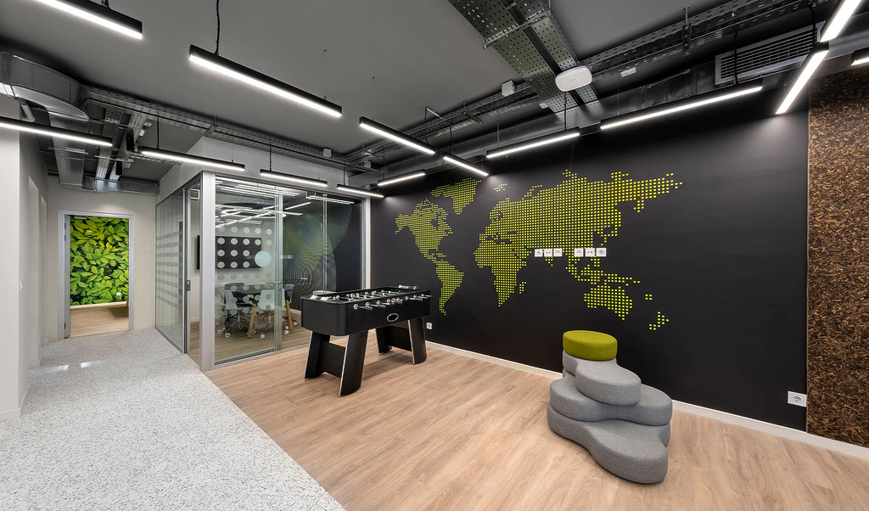
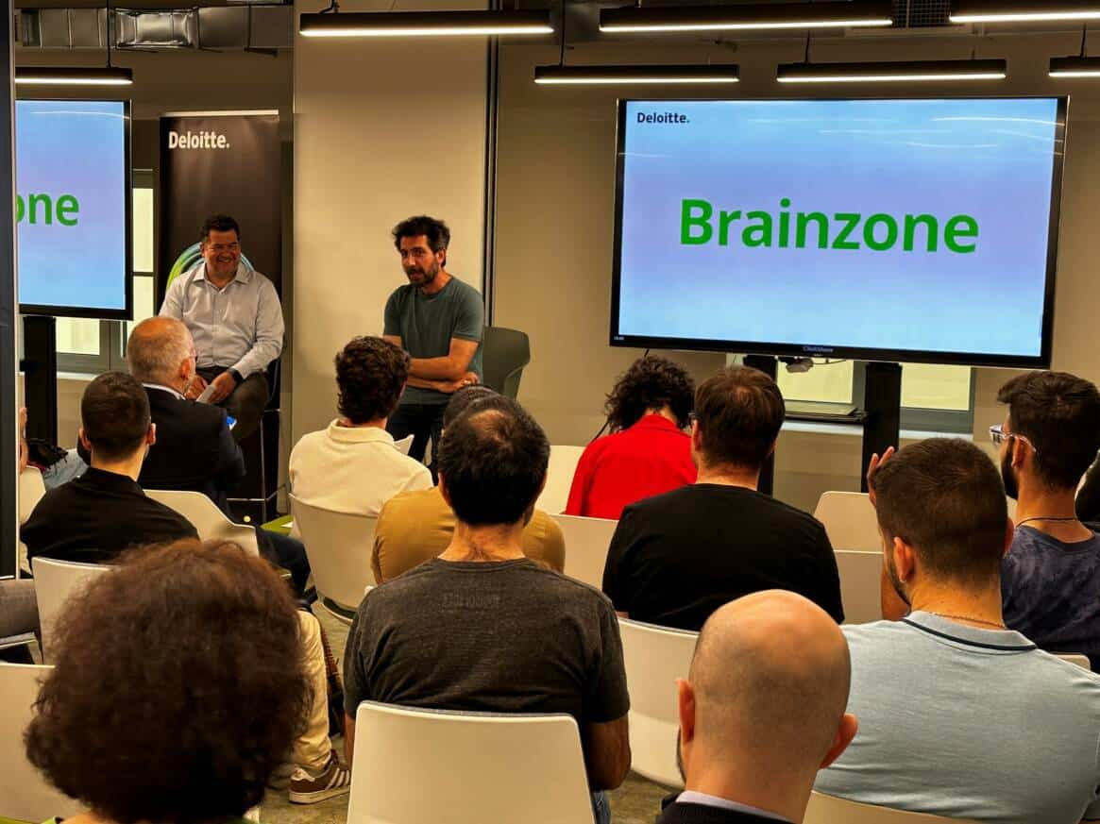
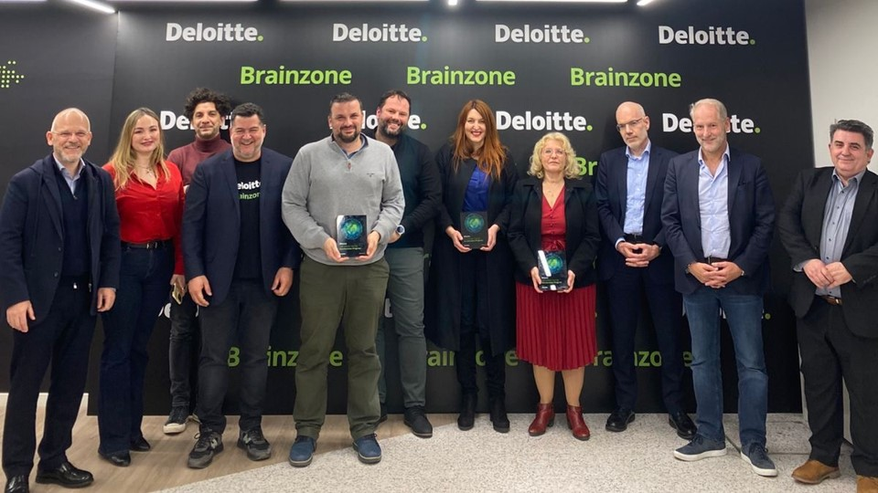


Deloitte StartUp Accelerator | Brainzone​
What is it?
Brainzone is Deloitte’s Innovation Hub in Patras, designed to accelerate entrepreneurship and strengthen the local innovation ecosystem by supporting startups, students, and researchers in transforming ideas into impactful businesses.
Innovation Hub
Meetups
Startup Acceleration
9th Meetup Brains and Robots: AI Driven Automation in practice!
Latest Edition
© 2026 For more information contact Deloitte Central Mediterranean | 14

Slide 15
Deloitte StartUp Accelerator | About​
Office Space & Facilities
Access to fully equipped office infrastructure in the Brainzone Hub, including reception, printing, and meeting rooms, providing startups with a professional environment to collaborate and grow.
Advisory & Mentoring Tailored mentoring and coaching from Deloitte professionals, covering business planning, financial modeling, fundability analysis, and investment readiness to prepare startups for sustainable growth.
Services / Offerings
Industry Connections
Direct links to major industry players, corporates, and stakeholders, enabling valuable feedback, networking, and the opportunity to run Proof of Concept (PoC) projects in real business environments.
Investor Engagement
Introductions to venture capital funds, family offices, and strategic investors, facilitating early discussions that can lead to funding opportunities and long-term partnerships.
© 2026 For more information contact Deloitte Central Mediterranean | 15

Slide 16














Deloitte StartUp Accelerator | Past Participants​
STARTUPS
LucaHealth
by Vasileios Nikolaou
Deloitte
Mismatch
by Loukas Leonardos
1st
2nd
Pop2See
by A.Rangou
AimaLabs
by Vaso Vlacha
The inaugural Accelerator in January 2024 selected 4 startups from 42 applicants, offering 6
months of mentoring, workshops, and access to a collaborative innovation hub, culminating in a final pitching event with investors and ecosystem partners.
Running from February to July 2025, the 2nd cycle supported 4 startups developing tech-driven solutions ,providing workspace, networking, and mentorship. It concluded with a demo day where teams showcased their progress,
Aeroponics
by C.Stefanou
MyGaia
by Christos Xouris
eSki
by E.Kinis & E. Kostouros
Quetz Lab
by Irene Ioannidou
SELECTION COMMITTEE
Pitching event: Numerous proposals were submitted by startups, students and recent graduates throughout the two cycles.
Selection Committee: The committee included ecosystem leaders such as fund partners, CEOs, industry and government representatives.
© 2026 For more information contact Deloitte Central Mediterranean | 16

Slide 17



Deloitte StartUp Accelerator | Current Participants​
Anthestos Pharmaceuticals
Anthestos Pharmaceuticals is a University of Patras spin-off developing a novel topical retinoid for skin diseases, aiming for high efficacy with reduced irritation and lower cost.
X-Ray Mobility
X-Ray Mobility is an AI and AR platform that turns smart-city cameras into a real-time road-safety layer, predicting hazards and delivering instant AR warnings to road users.
Find your Space
FindYourSpace is an on-demand marketplace that connects users with flexible professional and event spaces, helping businesses monetize unused rooms through quick, transparent search and booking.
© 2026 For more information contact Deloitte Central Mediterranean | 17

Slide 18
Deloitte StartUp Accelerator | Highlights​
11 Startups
100+ Applications
Involved in multiple sectors like Agritech, Edtech , Healthtech Pharma, AR and Sportstech
More than 100 applications received from startups and founders at different stages of development
20 Dedicated Advisors
Additional mentorship offered by supporting staff on a need's basis
Brainzone
3 Cycles
100+ Mentoring Hours
Which included pitch events, meetups and community engagement with both academia and the local ecosystem
With various functions involved depending on needs across both cycles
© 2026 For more information contact Deloitte Central Mediterranean | 18

Slide 19





Deloitte StartUp Accelerator | Impact​
AimaLabs proudly achieved 2nd place out of 35 startups at the Beyond StartUp Village
A
PoP2See was selected for the Amazon Web Services & Deloitte US Social Entrepreneur Accelerator Program (SEA), which supports social ventures through cloud-based solutions
B
LucaHealth successfully raised funds after pivoting its business plan with Deloitte’s support.
C
Mismatch had a meeting with Novibet arranged through Deloitte to discuss potential collaboration opportunities
D
MyGaia meeting with Piraeus Bank to explore synergies for an Agritech initiative
E
© 2026 For more information contact Deloitte Central Mediterranean | 19

Slide 20

Deloitte StartUp Accelerator | 3rd Cycle Timeline ​
Applications Open
October 16, 2025
01
Live Pitching
January 22, 2025
03
Acceleration Period
February 2026 – July 2026
02
04
WE ARE HERE
Applications Close
05
December 12 , 2025
Final Presentation
Mid July 2026
© 2026 For more information contact Deloitte Central Mediterranean | 20

Slide 21


Deloitte
Open
Discussion

Slide 22
This document has been prepared by Deloitte Business Solutions Societe Anonyme of Business Consultants, Deloitte Certified Public Accountants Societe Anonyme and Deloitte Alexander Competence Center Single Member Societe Anonyme of Business Consultants.
Deloitte Business Solutions Societe Anonyme of Business Consultants, a Greek company, registered in Greece with registered number 000665201000 and its registered office at Marousi Attica, 3a Fragkokklisias & Granikou str., 151 25, Deloitte Certified Public Accountants Societe Anonyme, a Greek company, registered in Greece with registered number 0001223601000 and its registered office at Marousi, Attica, 3a Fragkokklisias & Granikou str., 151 25 and Deloitte Alexander Competence Center Single Member Societe Anonyme of Business Consultants, a Greek company, registered in Greece with registered number 144724504000 and its registered office at Thessaloniki, Municipality of Pylaia - Chortiatis of Thessaloniki, Vepe Technopolis Thessaloniki (5th and 3rd street), are all companies of the Deloitte Central Mediterranean S.r.l. (“DCM”) geography. DCM, a company limited by guarantee registered in Italy with registered number 09599600963 and its registered office at Via Santa Sofia no. 28, 20122, Milan, Italy is one of the Deloitte NSE LLP geographies. Deloitte NSE LLP is a UK limited liability partnership and member firm of Deloitte Touche Tohmatsu Limited, a UK private company limited by guarantee.
Deloitte refers to one or more of Deloitte Touche Tohmatsu Limited (“DTTL”), its global network of member firms and their related entities (collectively, the “Deloitte organization”). DTTL (also referred to as “Deloitte Global”) and each of its member firms and related entities are legally separate and independent entities, which cannot obligate or bind each other in respect of third parties. DTTL and each DTTL member firm and related entity is liable only for its own acts and omissions, and not those of any of each other. DTTL does not provide services to clients. Please see www.deloitte.com/ about to learn more.
DTTL, Deloitte NSE LLP and Deloitte Central Mediterranean S.r.l. do not provide services to clients. Please see www.deloitte.com/about to learn more about our global network of member firms.
Deloitte is a leading global provider of audit and assurance, consulting, tax and related services. Our global network of member firms and related entities in more than 150 countries and territories serves four out of five Fortune Global 500® companies. Learn how Deloitte’s approximately 460,300 people make an impact that matters at www.deloitte.com.
This document and its contents are confidential and prepared solely for your use, and may not be reproduced, redistributed or passed on to any other person in whole or in part, unless otherwise expressly agreed with you. No other party is entitled to rely on this document for any purpose whatsoever and we accept no liability to any other party, who is provided with or obtains access or relies to this document.
© 2026 For more information contact Deloitte Central Mediterranean.

